Slide 1


Colonial Pipeline Ransomware Attack
(2021)
COSC 472 Network Security
By: Vincent Fealy

Slide 2


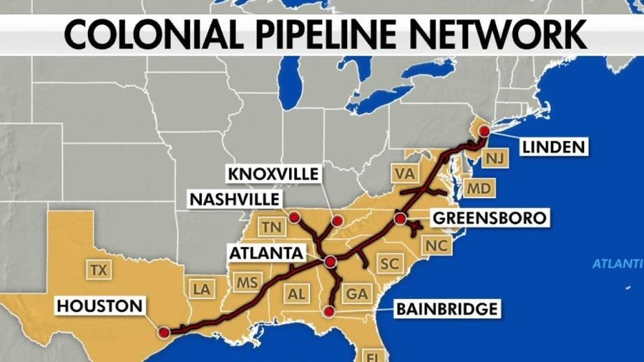
INTRODUCTION
The Colonial Pipeline ransomware attack, which occurred in May 2021, was one of the most disruptive attacks on critical infrastructure in the United States.
Why this case is important: The attack highlighted the vulnerabilities of essential services to cyberattacks and led to widespread disruptions across the East Coast.
02

Slide 3

ABOUT
Colonial Pipeline: Largest fuel pipeline system in the U.S., transporting 2.5 million barrels of fuel daily across 5,500 miles.
On May 7, 2021, Colonial Pipeline’s IT systems were compromised by a ransomware attack from the DarkSide group, leading to the shutdown of operations for six days.
BACKGROUND
IMPACT
Panic buying and fuel shortages on the East Coast.
Financial loss: $4.4 million ransom paid in Bitcoin.
Disruption of energy supply.
03

Slide 4
SECURITY ATTACK
Nature of the Attack:
Attackers gained access through a compromised password on a VPN account.
Ransomware was deployed by the cybercriminal group DarkSide.
Tactics:
DarkSide used a "double extortion" tactic encrypting data while also threatening to leak it if the ransom wasn’t paid.
Impact:
Shutdown of pipeline systems and business operations.
Widespread fuel shortages and economic loss.
company leaders decided to give into DarkSide’s demands and pay the ransom of 75 bitcoin (around $4.4m)
04

Slide 5

SECURITY MECHANISMS BEFORE THE ATTACK
Existing mechanisms
Basic network segmentation separating IT and OT (Operational Technology) systems.
Security monitoring and firewalls in place.
Why they failed
Compromised password: Use of a weak password without multi-factor authentication (MFA).
Lack of ransomware-specific defenses or incident response plan tailored for ransomware.
05

Slide 6
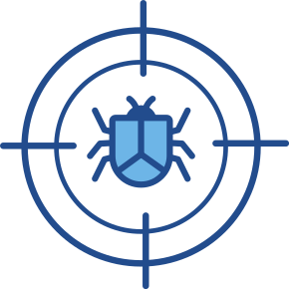
Encryption Role in Ransomware
Ransomware attacks like DarkSide’s rely on advanced cryptographic algorithms to lock users out of their own systems.
CRYPTOGRAPHY FUNDAMENTALS
Encryption Process
Attackers encrypt data using a symmetric encryption algorithm.
Private decryption keys are held by the attackers, requiring victims to pay for the key to unlock their files.
Challenges
Encryption is a double-edged sword it protects data from unauthorized access, but it also makes ransomware highly effective.
06

Slide 7

DEFENDING & COUNTERMEASURES
Immediate Countermeasures
Colonial paid the ransom to retrieve decryption keys and restored their systems.
Long-term Countermeasures
Multi-factor authentication (MFA): Mandatory MFA for all remote access.
Network segmentation: Further segmentation between IT and OT systems to limit the spread of future attacks.
Zero-trust security model: Only allow access based on a strict verification process.
Employee training: Regular phishing simulations and cybersecurity awareness programs.
Regular backups: Ensuring frequent backups of critical data and testing restoration processes.
07

Slide 8


LESSONS LEARNED & INDUSTRY IMPACT
The critical need for securing critical infrastructure against ransomware.
Importance of cybersecurity hygiene (strong passwords, MFA, backups).
Cybersecurity awareness at all levels of the organization.
Government response: Biden’s executive order on improving U.S. cybersecurity, mandating stronger security practices for critical infrastructure.
Increase in ransomware-specific defenses across industries.
08

Slide 9
CONCLUSION
KEY POINTS
Colonial Pipeline ransomware attack exposed the vulnerabilities of critical infrastructure.
Encryption was a key weapon in the attack, but strong security protocols could have mitigated its impact.
Robust defenses, including zero-trust models and regular backups, are essential to prevent future ransomware attacks.
09

Slide 10

THANK YOU FOR YOUR ATTENTION
QUESTIONS?
10

Slide 11
Sources
“The Colonial Pipeline Cyberattack: How to Prevent Such Episodes?” Sectrio, 13 May 2021, sectrio.com/blog/colonial-pipeine-how-to-prevent-such-attacks/.
Kerner, Sean Michael. “Colonial Pipeline Hack Explained: Everything You Need to Know.” WhatIs, TechTarget, 26 Apr. 2022, www.techtarget.com/whatis/feature/Colonial-Pipeline-hack-explained-Everything-you-need-to-know.
Wallix. “What Happened in the Colonial Pipeline Ransomware Attack.” WALLIX, 9 Sept. 2024, www.wallix.com/what-happened-in-the-colonial-pipeline-ransomware-attack-2/.
Aksakal, Cem. “Case Overview: Colonial Pipeline Ransomware Attack.” Medium, Medium, 3 Nov. 2023, medium.com/@cem.aksakal7/case-overview-colonial-pipeline-ransomware-attack-5cce42e106e5.
Cora QuigleyCora is a digital copywriter for SSLs.com. Having eight years of experience in online content creation. “The Ransomware Group behind the Colonial Pipeline Attack.” SSLs.Com Blog, 27 May 2021, www.ssls.com/blog/the-ransomware-group-behind-the-colonial-pipeline-attack/.

